Slide 1
Data Mining:
Concepts and Techniques
(3rd ed.)
— Chapter 4 —
Jiawei Han, Micheline Kamber, and Jian Pei
University of Illinois at Urbana-Champaign &
Simon Fraser University
©2011 Han, Kamber & Pei. All rights reserved.

Slide 2
Chapter 4: Association Rule Mining
1. Basic Concepts
2. Frequent Itemset Mining Methods
3. Which Patterns Are Interesting?—Pattern Evaluation Methods
4. Pattern Mining in Multi-Level, Multi-Dimensional Space
5. Constraint-Based Frequent Pattern Mining
6. Mining High-Dimensional Data and Colossal Patterns
7. Mining Compressed or Approximate Patterns
8. Pattern Exploration and Application
9. Summary

Slide 3
What Is Frequent Pattern Analysis?
Frequent pattern: a pattern (a set of items, subsequences, substructures, etc.) that occurs frequently in a data set
First proposed by Agrawal, Imielinski, and Swami [AIS93] in the context of frequent itemsets and association rule mining
Motivation: Finding inherent regularities in data
  What products were often purchased together?— Beer and diapers?!
  What are the subsequent purchases after buying a PC?
  What kinds of DNA are sensitive to this new drug?
  Can we automatically classify web documents?
Applications
  Basket data analysis, cross-marketing, catalog design, sale campaign analysis, Web log (click stream) analysis, and DNA sequence analysis.

Slide 4
Why Is Freq. Pattern Mining Important?
Freq. pattern: An intrinsic and important property of datasets
Foundation for many essential data mining tasks
  Association, correlation, and causality analysis
  Sequential, structural (e.g., sub-graph) patterns
  Pattern analysis in spatiotemporal, multimedia, time-series, and stream data
  Classification: discriminative, frequent pattern analysis
  Cluster analysis: frequent pattern-based clustering
  Data warehousing: iceberg cube and cube-gradient
  Semantic data compression: fascicles
  Broad applications

Slide 5
Basic Concepts: Frequent Patterns
Tid | Items bought
10 | Beer, Nuts, Diaper
20 | Beer, Coffee, Diaper
30 | Beer, Diaper, Eggs
40 | Nuts, Eggs, Milk
50 | Nuts, Coffee, Diaper, Eggs, Milk
itemset: A set of one or more items
k-itemset X = {x₁, …, x_{k}}
(absolute) support, or, support count of X: Frequency or occurrence of an itemset X
(relative) support, s, is the fraction of transactions that contains X (i.e., the probability that a transaction contains X)
An itemset X is frequent if X’s support is no less than a minsup threshold
Customer
buys both
Customer
buys diaper
Customer
buys beer

Slide 6
Basic Concepts: Association Rules
Tid
Items bought
Find all the rules X → Y with minimum support and confidence
  support, s, probability that a transaction contains X ∪ Y
  confidence, c, conditional probability that a transaction having X also contains Y
Let minsup = 50%, minconf = 50%
Freq. Pat.: Beer:3, Nuts:3, Diaper:4, Eggs:3, {Beer, Diaper}:3
10
Beer, Nuts, Diaper
20
Beer, Coffee, Diaper
30
Beer, Diaper, Eggs
40
Nuts, Eggs, Milk
50
Nuts, Coffee, Diaper, Eggs, Milk
Customer
buys both
Customer
buys diaper
Customer
buys beer
Association rules: (many more!)
  Beer → Diaper (60%, 100%)
  Diaper → Beer (60%, 75%)

Slide 7
Closed Patterns and Max-Patterns
A long pattern contains a combinatorial number of sub-patterns, e.g., {a₁, …, a₁₀₀} contains (₁₀₀¹) + (₁₀₀²) + … + (₁¹₀⁰₀⁰) = 2¹⁰⁰ – 1 = 1.27*10³⁰ sub-patterns!
Solution: Mine closed patterns and max-patterns instead
An itemset X is closed if X is frequent and there exists no super-pattern Y כ X, with the same support as X (proposed by Pasquier, et al. @ ICDT’99)
An itemset X is a max-pattern if X is frequent and there exists no frequent super-pattern Y כ X (proposed by Bayardo @ SIGMOD’98)
Closed pattern is a lossless compression of freq. patterns
  Reducing the # of patterns and rules

Slide 8
Closed Patterns and Max-Patterns
Exercise. DB = {<a₁, …, a₁₀₀>, < a₁, …, a₅₀>}
  Min_sup = 1.
What is the set of closed itemset?
  <a₁, …, a₁₀₀>: 1
  < a₁, …, a₅₀>: 2
What is the set of max-pattern?
  <a₁, …, a₁₀₀>: 1
What is the set of all patterns?
  !!

Slide 9
Computational Complexity of Frequent Itemset Mining
How many itemsets are potentially to be generated in the worst case?
  The number of frequent itemsets to be generated is senstive to the minsup threshold
  When minsup is low, there exist potentially an exponential number of frequent itemsets
  The worst case: M^{N} where M: # distinct items, and N: max length of transactions
The worst case complexity vs. the expected probability
  Ex. Suppose Walmart has 10⁴ kinds of products
    The chance to pick up one product 10⁻⁴
    The chance to pick up a particular set of 10 products: ~10⁻⁴⁰
    What is the chance this particular set of 10 products to be frequent 10³ times in 10⁹ transactions?

Slide 10
The Downward Closure Property and Scalable Mining Methods
The downward closure property of frequent patterns
  Any subset of a frequent itemset must be frequent
  If {beer, diaper, nuts} is frequent, so is {beer, diaper}
  i.e., every transaction having {beer, diaper, nuts} also contains {beer, diaper}
Scalable mining methods: Three major approaches
  Apriori (Agrawal & Srikant@VLDB’94)
  Freq. pattern growth (FPgrowth—Han, Pei & Yin @SIGMOD’00)
  Vertical data format approach (Charm—Zaki & Hsiao @SDM’02)

Slide 11
Scalable Frequent Itemset Mining Methods
Apriori: A Candidate Generation-and-Test Approach
Improving the Efficiency of Apriori
FPGrowth: A Frequent Pattern-Growth Approach
ECLAT: Frequent Pattern Mining with Vertical Data Format

Slide 12
Apriori: A Candidate Generation & Test Approach
Apriori pruning principle: If there is any itemset which is infrequent, its superset should not be generated/tested! (Agrawal & Srikant @VLDB’94, Mannila, et al. @ KDD’ 94)
Method:
  Initially, scan DB once to get frequent 1-itemset
  Generate length (k+1) candidate itemsets from length k frequent itemsets
  Test the candidates against DB
  Terminate when no frequent or candidate set can be generated

Slide 13
The Apriori Algorithm—An Example
Sup_{min} = 2
Itemset | sup
{A} | 2
{B} | 3
{C} | 3
{D} | 1
{E} | 3
Database TDB
Itemset | sup
{A} | 2
{B} | 3
{C} | 3
{E} | 3
L₁
Tid | Items
10 | A, C, D
20 | B, C, E
30 | A, B, C, E
40 | B, E
C₁
1st scan
C₂
Itemset | sup
{A, B} | 1
{A, C} | 2
{A, E} | 1
{B, C} | 2
{B, E} | 3
{C, E} | 2
C₂
L₂
Itemset
{A, B}
{A, C}
{A, E}
{B, C}
{B, E}
{C, E}
Itemset | sup
{A, C} | 2
{B, C} | 2
{B, E} | 3
{C, E} | 2
2nd scan
C₃
Itemset
{B, C, E}
3rd scan
L₃
Itemset | sup
{B, C, E} | 2

Slide 14
The Apriori Algorithm (Pseudo-Code)
C_{k}: Candidate itemset of size k
L_{k} : frequent itemset of size k
L₁ = {frequent items};
for (k = 1; L_{k} !=∅; k++) do begin
C_{k+1} = candidates generated from L_{k};
for each transaction t in database do
  increment the count of all candidates in C_{k+1} that are contained in t
L_{k+1} = candidates in C_{k+1} with min_support
end
return ∪_{k} L_{k};

Slide 15
Implementation of Apriori
How to generate candidates?
  Step 1: self-joining L_{k}
  Step 2: pruning
Example of Candidate-generation
  L₃={abc, abd, acd, ace, bcd}
  Self-joining: L₃*L₃
    abcd from abc and abd
    acde from acd and ace
  Pruning:
    acde is removed because ade is not in L₃
  C₄ = {abcd}

Slide 16
How to Count Supports of Candidates?
Why counting supports of candidates a problem?
  The total number of candidates can be very huge
  One transaction may contain many candidates
Method:
  Candidate itemsets are stored in a hash-tree
  Leaf node of hash-tree contains a list of itemsets and counts
  Interior node contains a hash table
  Subset function: finds all the candidates contained in a transaction

Slide 17
Counting Supports of Candidates Using Hash Tree
Subset function
Transaction: 1 2 3 5 6
3,6,9
1,4,7
2,5,8
1 + 2 3 5 6
1 3 + 5 6
2 3 4
5 6 7
1 4 5
3 4 5
3 5 6
3 5 7
6 8 9
3 6 7
3 6 8
1 3 6
1 2 + 3 5 6
1 2 4
4 5 7
1 2 5
4 5 8
1 5 9

Slide 18
Candidate Generation: An SQL Implementation
SQL Implementation of candidate generation
  Suppose the items in L_{k-1} are listed in an order
  Step 1: self-joining L_{k-1}
    insert into C_{k}
    select p.item₁, p.item₂, …, p.item_{k-1}, q.item_{k-1}
    from L_{k-1} p, L_{k-1} q
    where p.item₁=q.item₁, …, p.item_{k-2}=q.item_{k-2}, p.item_{k-1} < q.item_{k-1}
  Step 2: pruning
    forall itemsets c in C_{k} do
      forall (k-1)-subsets s of c do
        if (s is not in L_{k-1}) then delete c from C_{k}
Use object-relational extensions like UDFs, BLOBs, and Table functions for efficient implementation [See: S. Sarawagi, S. Thomas, and R. Agrawal. Integrating association rule mining with relational database systems: Alternatives and implications. SIGMOD’98]

Slide 19
Scalable Frequent Itemset Mining Methods
Apriori: A Candidate Generation-and-Test Approach
Improving the Efficiency of Apriori
FPGrowth: A Frequent Pattern-Growth Approach
ECLAT: Frequent Pattern Mining with Vertical Data Format
Mining Close Frequent Patterns and Maxpatterns

Slide 20
Further Improvement of the Apriori Method
Major computational challenges
  Multiple scans of transaction database
  Huge number of candidates
  Tedious workload of support counting for candidates
Improving Apriori: general ideas
  Reduce passes of transaction database scans
  Shrink number of candidates
  Facilitate support counting of candidates

Slide 21
Partition: Scan Database Only Twice
Any itemset that is potentially frequent in DB must be frequent in at least one of the partitions of DB
  Scan 1: partition database and find local frequent patterns
  Scan 2: consolidate global frequent patterns
A. Savasere, E. Omiecinski and S. Navathe, VLDB’95
DB₁
+
DB₂
+
+
DB_{k}
= DB
sup₁(i) < σDB₁
sup₂(i) < σDB₂
sup_{k}(i) < σDB_{k}
sup(i) < σDB

Slide 22
DHP: Reduce the Number of Candidates
A k-itemset whose corresponding hashing bucket count is below the threshold cannot be frequent
  Candidates: a, b, c, d, e
  Hash entries
    {ab, ad, ae}
    {bd, be, de}
    …
  Frequent 1-itemset: a, b, d, e
  ab is not a candidate 2-itemset if the sum of count of {ab, ad, ae} is below support threshold
J. Park, M. Chen, and P. Yu. An effective hash-based algorithm for mining association rules. SIGMOD’95
count
itemsets
35
{ab, ad, ae}
88
{bd, be, de}
...
...
102
{yz, qs, wt}
Hash Table

Slide 23
Sampling for Frequent Patterns
Select a sample of original database, mine frequent patterns within sample using Apriori
Scan database once to verify frequent itemsets found in sample, only borders of closure of frequent patterns are checked
  Example: check abcd instead of ab, ac, …, etc.
Scan database again to find missed frequent patterns
H. Toivonen. Sampling large databases for association rules. In VLDB’96

Slide 24
DIC: Reduce Number of Scans
ABCD
Once both A and D are determined frequent, the counting of AD begins
Once all length-2 subsets of BCD are determined frequent, the counting of BCD begins
ABC
ABD
ACD
BCD
AB
AC
BC
AD
BD
CD
Transactions
1-itemsets
A
B
C
D
Apriori
2-itemsets
…
{}
Itemset lattice
1-itemsets
2-items
S. Brin R. Motwani, J. Ullman, and S. Tsur. Dynamic itemset counting and implication rules for market basket data. SIGMOD’97
DIC
3-items

Slide 25
Scalable Frequent Itemset Mining Methods
Apriori: A Candidate Generation-and-Test Approach
Improving the Efficiency of Apriori
FPGrowth: A Frequent Pattern-Growth Approach
ECLAT: Frequent Pattern Mining with Vertical Data Format
Mining Close Frequent Patterns and Maxpatterns

Slide 26
Pattern-Growth Approach: Mining Frequent Patterns Without Candidate Generation
Bottlenecks of the Apriori approach
  Breadth-first (i.e., level-wise) search
  Candidate generation and test
    Often generates a huge number of candidates
The FPGrowth Approach (J. Han, J. Pei, and Y. Yin, SIGMOD’ 00)
  Depth-first search
  Avoid explicit candidate generation
Major philosophy: Grow long patterns from short ones using local frequent items only
  “abc” is a frequent pattern
  Get all transactions having “abc”, i.e., project DB on abc: DB|abc
  “d” is a local frequent item in DB|abc → abcd is a frequent pattern

Slide 27
Construct FP-tree from a Transaction Database
TID Items bought (ordered) frequent items
100 {f, a, c, d, g, i, m, p} {f, c, a, m, p}
200 {a, b, c, f, l, m, o} {f, c, a, b, m}
300 {b, f, h, j, o, w} {f, b}
400 {b, c, k, s, p} {c, b, p}
500 {a, f, c, e, l, p, m, n} {f, c, a, m, p}
min_support = 3
{}
Header Table
Item frequency head
f 4
c 4
a 3
b 3
m 3
p 3
Scan DB once, find frequent 1-itemset (single item pattern)
Sort frequent items in frequency descending order, f-list
Scan DB again, construct FP-tree
f:4
c:1
c:3
b:1
b:1
a:3
p:1
m:2
b:1
F-list = f-c-a-b-m-p
p:2
m:1

Slide 28
Partition Patterns and Databases
Frequent patterns can be partitioned into subsets according to f-list
  F-list = f-c-a-b-m-p
  Patterns containing p
  Patterns having m but no p
  …
  Patterns having c but no a nor b, m, p
  Pattern f
Completeness and non-redundency

Slide 29
Find Patterns Having P From P-conditional Database
Starting at the frequent item header table in the FP-tree
Traverse the FP-tree by following the link of each frequent item p
Accumulate all of transformed prefix paths of item p to form p’s conditional pattern base
{}
Header Table
Item frequency head
f 4
c 4
a 3
b 3
m 3
p 3
f:4
c:1
Conditional pattern bases
item cond. pattern base
c f:3
a fc:3
b fca:1, f:1, c:1
m fca:2, fcab:1
p fcam:2, cb:1
c:3
b:1
b:1
a:3
p:1
m:2
b:1
p:2
m:1

Slide 30
From Conditional Pattern-bases to Conditional FP-trees
For each pattern-base
  Accumulate the count for each item in the base
  Construct the FP-tree for the frequent items of the pattern base
m-conditional pattern base:
  fca:2, fcab:1
{}
Header Table
Item frequency head
f 4
c 4
a 3
b 3
m 3
p 3
f:4
c:1
All frequent patterns relate to m
m,
fm, cm, am,
fcm, fam, cam,
fcam
{}
c:3
b:1
b:1

f:3

a:3
p:1
m:2
b:1
c:3
p:2
m:1
a:3
m-conditional FP-tree

Slide 31
Recursion: Mining Each Conditional FP-tree
{}
{}
Cond. pattern base of “am”: (fc:3)
f:3
c:3
f:3
am-conditional FP-tree
c:3
{}
Cond. pattern base of “cm”: (f:3)
a:3
f:3
m-conditional FP-tree
cm-conditional FP-tree
{}
Cond. pattern base of “cam”: (f:3)
f:3
cam-conditional FP-tree

Slide 32
A Special Case: Single Prefix Path in FP-tree
Suppose a (conditional) FP-tree T has a shared single prefix-path P
Mining can be decomposed into two parts
  Reduction of the single prefix path into one node
  Concatenation of the mining results of the two parts
{}
a₁:n₁
a₂:n₂
a₃:n₃
{}
r₁
b₁:m₁
C₁:k₁
a₁:n₁
+

r₁
=
b₁:m₁
C₁:k₁
a₂:n₂
C₂:k₂
C₃:k₃
a₃:n₃
C₂:k₂
C₃:k₃

Slide 33
Benefits of the FP-tree Structure
Completeness
  Preserve complete information for frequent pattern mining
  Never break a long pattern of any transaction
Compactness
  Reduce irrelevant info—infrequent items are gone
  Items in frequency descending order: the more frequently occurring, the more likely to be shared
  Never be larger than the original database (not count node-links and the count field)

Slide 34
The Frequent Pattern Growth Mining Method
Idea: Frequent pattern growth
  Recursively grow frequent patterns by pattern and database partition
Method
  For each frequent item, construct its conditional pattern-base, and then its conditional FP-tree
  Repeat the process on each newly created conditional FP-tree
  Until the resulting FP-tree is empty, or it contains only one path—single path will generate all the combinations of its sub-paths, each of which is a frequent pattern

Slide 35
Scaling FP-growth by Database Projection
What about if FP-tree cannot fit in memory?
  DB projection
First partition a database into a set of projected DBs
Then construct and mine FP-tree for each projected DB
Parallel projection vs. partition projection techniques
  Parallel projection
    Project the DB in parallel for each frequent item
    Parallel projection is space costly
    All the partitions can be processed in parallel
  Partition projection
    Partition the DB based on the ordered frequent items
    Passing the unprocessed parts to the subsequent partitions

Slide 36
Partition-Based Projection
Parallel projection needs a lot of disk space
Partition projection saves it
Tran. DB
fcamp
fcabm
fb
cbp
fcamp
p-proj DB
fcam
cb
fcam
m-proj DB
fcab
fca
fca
b-proj DB
f
cb
…
a-proj DB
fc
…
c-proj DB
f
…
f-proj DB
…
am-proj DB
fc
fc
fc
cm-proj DB
f
f
f
…

Slide 37


Performance of FPGrowth in Large Datasets
Data set T25I20D10K
Data set T25I20D100K
FP-Growth vs. Apriori
FP-Growth vs. Tree-Projection

Slide 38
Advantages of the Pattern Growth Approach
Divide-and-conquer:
  Decompose both the mining task and DB according to the frequent patterns obtained so far
  Lead to focused search of smaller databases
Other factors
  No candidate generation, no candidate test
  Compressed database: FP-tree structure
  No repeated scan of entire database
  Basic ops: counting local freq items and building sub FP-tree, no pattern search and matching
A good open-source implementation and refinement of FPGrowth
  FPGrowth+ (Grahne and J. Zhu, FIMI'03)

Slide 39
Further Improvements of Mining Methods
AFOPT (Liu, et al. @ KDD’03)
  A “push-right” method for mining condensed frequent pattern (CFP) tree
Carpenter (Pan, et al. @ KDD’03)
  Mine data sets with small rows but numerous columns
  Construct a row-enumeration tree for efficient mining
FPgrowth+ (Grahne and Zhu, FIMI’03)
  Efficiently Using Prefix-Trees in Mining Frequent Itemsets, Proc. ICDM'03 Int. Workshop on Frequent Itemset Mining Implementations (FIMI'03), Melbourne, FL, Nov. 2003
TD-Close (Liu, et al, SDM’06)

Slide 40
Extension of Pattern Growth Mining Methodology
Mining closed frequent itemsets and max-patterns
  CLOSET (DMKD’00), FPclose, and FPMax (Grahne & Zhu, Fimi’03)
Mining sequential patterns
  PrefixSpan (ICDE’01), CloSpan (SDM’03), BIDE (ICDE’04)
Mining graph patterns
  gSpan (ICDM’02), CloseGraph (KDD’03)
Constraint-based mining of frequent patterns
  Convertible constraints (ICDE’01), gPrune (PAKDD’03)
Computing iceberg data cubes with complex measures
  H-tree, H-cubing, and Star-cubing (SIGMOD’01, VLDB’03)
Pattern-growth-based Clustering
  MaPle (Pei, et al., ICDM’03)
Pattern-Growth-Based Classification
  Mining frequent and discriminative patterns (Cheng, et al, ICDE’07)

Slide 41
Scalable Frequent Itemset Mining Methods
Apriori: A Candidate Generation-and-Test Approach
Improving the Efficiency of Apriori
FPGrowth: A Frequent Pattern-Growth Approach
ECLAT: Frequent Pattern Mining with Vertical Data Format
Mining Close Frequent Patterns and Maxpatterns

Slide 42
ECLAT: Mining by Exploring Vertical Data Format
Vertical format: t(AB) = {T₁₁, T₂₅, …}
  tid-list: list of trans.-ids containing an itemset
Deriving frequent patterns based on vertical intersections
  t(X) = t(Y): X and Y always happen together
  t(X) ⊂ t(Y): transaction having X always has Y
Using diffset to accelerate mining
  Only keep track of differences of tids
  t(X) = {T₁, T₂, T₃}, t(XY) = {T₁, T₃}
  Diffset (XY, X) = {T₂}
Eclat (Zaki et al. @KDD’97)
Mining Closed patterns using vertical format: CHARM (Zaki & Hsiao@SDM’02)

Slide 43
Scalable Frequent Itemset Mining Methods
Apriori: A Candidate Generation-and-Test Approach
Improving the Efficiency of Apriori
FPGrowth: A Frequent Pattern-Growth Approach
ECLAT: Frequent Pattern Mining with Vertical Data Format
Mining Close Frequent Patterns and Maxpatterns

Slide 44
Mining Frequent Closed Patterns: CLOSET
Flist: list of all frequent items in support ascending order
  Flist: d-a-f-e-c
Divide search space
  Patterns having d
  Patterns having d but no a, etc.
Find frequent closed pattern recursively
  Every transaction having d also has cfa → cfad is a frequent closed pattern
J. Pei, J. Han & R. Mao. “CLOSET: An Efficient Algorithm for Mining Frequent Closed Itemsets", DMKD'00.
Min_sup=2
TID | Items
10 | a, c, d, e, f
20 | a, b, e
30 | c, e, f
40 | a, c, d, f
50 | c, e, f

Slide 45
CLOSET+: Mining Closed Itemsets by Pattern-Growth
Itemset merging: if Y appears in every occurrence of X, then Y is merged with X
Sub-itemset pruning: if Y כ X, and sup(X) = sup(Y), X and all of X’s descendants in the set enumeration tree can be pruned
Hybrid tree projection
  Bottom-up physical tree-projection
  Top-down pseudo tree-projection
Item skipping: if a local frequent item has the same support in several header tables at different levels, one can prune it from the header table at higher levels
Efficient subset checking

Slide 46
MaxMiner: Mining Max-Patterns
1st scan: find frequent items
  A, B, C, D, E
2nd scan: find support for
  AB, AC, AD, AE, ABCDE
  BC, BD, BE, BCDE
  CD, CE, CDE, DE
Since BCDE is a max-pattern, no need to check BCD, BDE, CDE in later scan
R. Bayardo. Efficiently mining long patterns from databases. SIGMOD’98
Tid | Items
10 | A, B, C, D, E
20 | B, C, D, E,
30 | A, C, D, F
Potential max-patterns

Slide 47
CHARM: Mining by Exploring Vertical Data Format
Vertical format: t(AB) = {T₁₁, T₂₅, …}
  tid-list: list of trans.-ids containing an itemset
Deriving closed patterns based on vertical intersections
  t(X) = t(Y): X and Y always happen together
  t(X) ⊂ t(Y): transaction having X always has Y
Using diffset to accelerate mining
  Only keep track of differences of tids
  t(X) = {T₁, T₂, T₃}, t(XY) = {T₁, T₃}
  Diffset (XY, X) = {T₂}
Eclat/MaxEclat (Zaki et al. @KDD’97), VIPER(P. Shenoy et al.@SIGMOD’00), CHARM (Zaki & Hsiao@SDM’02)

Slide 48

Visualization of Association Rules: Plane Graph

Slide 49

Visualization of Association Rules: Rule Graph

Slide 50

Visualization of Association Rules
(SGI/MineSet 3.0)

Slide 51



Interestingness Measure: Correlations (Lift)
play basketball ⇒ eat cereal [40%, 66.7%] is misleading
  The overall % of students eating cereal is 75% > 66.7%.
play basketball ⇒ not eat cereal [20%, 33.3%] is more accurate, although with lower support and confidence
Measure of dependent/correlated events: lift
 | Basketball | Not basketball | Sum (row)
Cereal | 2000 | 1750 | 3750
Not cereal | 1000 | 250 | 1250
Sum(col.) | 3000 | 2000 | 5000

Slide 52

Are lift and χ² Good Measures of Correlation?
“Buy walnuts ⇒ buy milk [1%, 80%]” is misleading if 85% of customers buy milk
Support and confidence are not good to indicate correlations
Over 20 interestingness measures have been proposed (see Tan, Kumar, Sritastava @KDD’02)
Which are good ones?

Slide 53

Null-Invariant Measures

Slide 54


Comparison of Interestingness Measures
Null-(transaction) invariance is crucial for correlation analysis
Lift and χ² are not null-invariant
5 null-invariant measures
 | Milk | No Milk | Sum (row)
Coffee | m, c | ~m, c | c
No Coffee | m, ~c | ~m, ~c | ~c
Sum(col.) | m | ~m | Σ
Null-transactions w.r.t. m and c
Kulczynski measure (1927)
Null-invariant
Subtle: They disagree

Slide 55

Analysis of DBLP Coauthor Relationships
Recent DB conferences, removing balanced associations, low sup, etc.
Advisor-advisee relation: Kulc: high, coherence: low, cosine: middle
Tianyi Wu, Yuguo Chen and Jiawei Han, “Association Mining in Large Databases: A Re-Examination of Its Measures”, Proc. 2007 Int. Conf. Principles and Practice of Knowledge Discovery in Databases (PKDD'07), Sept. 2007

Slide 56


Which Null-Invariant Measure Is Better?
IR (Imbalance Ratio): measure the imbalance of two itemsets A and B in rule implications
Kulczynski and Imbalance Ratio (IR) together present a clear picture for all the three datasets D₄ through D₆
  D₄ is balanced & neutral
  D₅ is imbalanced & neutral
  D₆ is very imbalanced & neutral

Slide 57
Mining Multiple-Level Association Rules
Items often form hierarchies
Flexible support settings
  Items at the lower level are expected to have lower support
Exploration of shared multi-level mining (Agrawal & Srikant@VLB’95, Han & Fu@VLDB’95)
uniform support
reduced support
Level 1
min_sup = 5%
Milk
[support = 10%]
Level 1
min_sup = 5%
Level 2
min_sup = 5%
2% Milk
[support = 6%]
Skim Milk
[support = 4%]
Level 2
min_sup = 3%

Slide 58
Multi-level Association: Flexible Support and Redundancy filtering
Flexible min-support thresholds: Some items are more valuable but less frequent
  Use non-uniform, group-based min-support
  E.g., {diamond, watch, camera}: 0.05%; {bread, milk}: 5%; …
Redundancy Filtering: Some rules may be redundant due to “ancestor” relationships between items
  milk ⇒ wheat bread [support = 8%, confidence = 70%]
  2% milk ⇒ wheat bread [support = 2%, confidence = 72%]
  The first rule is an ancestor of the second rule
A rule is redundant if its support is close to the “expected” value, based on the rule’s ancestor

Slide 59
Mining Multi-Dimensional Association
Single-dimensional rules:
    buys(X, “milk”) ⇒ buys(X, “bread”)
Multi-dimensional rules: ≥ 2 dimensions or predicates
  Inter-dimension assoc. rules (no repeated predicates)
    age(X,”19-25”) ∧ occupation(X,“student”) ⇒ buys(X, “coke”)
  hybrid-dimension assoc. rules (repeated predicates)
    age(X,”19-25”) ∧ buys(X, “popcorn”) ⇒ buys(X, “coke”)
Categorical Attributes: finite number of possible values, no ordering among values—data cube approach
Quantitative Attributes: Numeric, implicit ordering among values—discretization, clustering, and gradient approaches

Slide 60
Mining Quantitative Associations
Techniques can be categorized by how numerical attributes, such as age or salary are treated
Static discretization based on predefined concept hierarchies (data cube methods)
Dynamic discretization based on data distribution (quantitative rules, e.g., Agrawal & Srikant@SIGMOD96)
Clustering: Distance-based association (e.g., Yang & Miller@SIGMOD97)
  One dimensional clustering then association
Deviation: (such as Aumann and Lindell@KDD99)
    Sex = female => Wage: mean=$7/hr (overall mean = $9)

Slide 61
Static Discretization of Quantitative Attributes
Discretized prior to mining using concept hierarchy.
Numeric values are replaced by ranges
In relational database, finding all frequent k-predicate sets will require k or k+1 table scans
Data cube is well suited for mining
The cells of an n-dimensional
  cuboid correspond to the
  predicate sets
Mining from data cubes
can be much faster
()
(age)
(income)
(buys)
(age, income)
(age,buys)
(income,buys)
(age,income,buys)

Slide 62
Quantitative Association Rules Based on Statistical Inference Theory [Aumann and Lindell@DMKD’03]
Finding extraordinary and therefore interesting phenomena, e.g.,
    (Sex = female) => Wage: mean=$7/hr (overall mean = $9)
  LHS: a subset of the population
  RHS: an extraordinary behavior of this subset
The rule is accepted only if a statistical test (e.g., Z-test) confirms the inference with high confidence
Subrule: highlights the extraordinary behavior of a subset of the pop. of the super rule
  E.g., (Sex = female) ^ (South = yes) => mean wage = $6.3/hr
Two forms of rules
  Categorical => quantitative rules, or Quantitative => quantitative rules
  E.g., Education in [14-18] (yrs) => mean wage = $11.64/hr
Open problem: Efficient methods for LHS containing two or more quantitative attributes

Slide 63
Negative and Rare Patterns
Rare patterns: Very low support but interesting
  E.g., buying Rolex watches
  Mining: Setting individual-based or special group-based support threshold for valuable items
Negative patterns
  Since it is unlikely that one buys Ford Expedition (an SUV car) and Toyota Prius (a hybrid car) together, Ford Expedition and Toyota Prius are likely negatively correlated patterns
Negatively correlated patterns that are infrequent tend to be more interesting than those that are frequent

Slide 64
Defining Negative Correlated Patterns (I)
Definition 1 (support-based)
  If itemsets X and Y are both frequent but rarely occur together, i.e.,
      sup(X U Y) < sup (X) * sup(Y)
  Then X and Y are negatively correlated
Problem: A store sold two needle 100 packages A and B, only one transaction containing both A and B.
  When there are in total 200 transactions, we have
    s(A U B) = 0.005, s(A) * s(B) = 0.25, s(A U B) < s(A) * s(B)
  When there are 10⁵ transactions, we have
    s(A U B) = 1/10⁵, s(A) * s(B) = 1/10^{3 *} 1/10³, s(A U B) > s(A) * s(B)
  Where is the problem? —Null transactions, i.e., the support-based definition is not null-invariant!

Slide 65
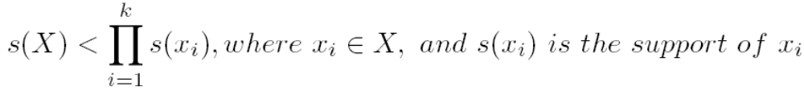
Defining Negative Correlated Patterns (II)
Definition 2 (negative itemset-based)
  X is a negative itemset if (1) X = Ā U B, where B is a set of positive items, and Ā is a set of negative items, |Ā|≥ 1, and (2) s(X) ≥ μ
  Itemsets X is negatively correlated, if
This definition suffers a similar null-invariant problem
Definition 3 (Kulzynski measure-based) If itemsets X and Y are frequent, but (P(X|Y) + P(Y|X))/2 < є, where є is a negative pattern threshold, then X and Y are negatively correlated.
Ex. For the same needle package problem, when no matter there are 200 or 10⁵ transactions, if є = 0.01, we have
    (P(A|B) + P(B|A))/2 = (0.01 + 0.01)/2 < є

Slide 66
Constraint-based (Query-Directed) Mining
Finding all the patterns in a database autonomously? — unrealistic!
  The patterns could be too many but not focused!
Data mining should be an interactive process
  User directs what to be mined using a data mining query language (or a graphical user interface)
Constraint-based mining
  User flexibility: provides constraints on what to be mined
  Optimization: explores such constraints for efficient mining — constraint-based mining: constraint-pushing, similar to push selection first in DB query processing
  Note: still find all the answers satisfying constraints, not finding some answers in “heuristic search”

Slide 67
Constraints in Data Mining
Knowledge type constraint:
  classification, association, etc.
Data constraint — using SQL-like queries
  find product pairs sold together in stores in Chicago this year
Dimension/level constraint
  in relevance to region, price, brand, customer category
Rule (or pattern) constraint
  small sales (price < $10) triggers big sales (sum > $200)
Interestingness constraint
  strong rules: min_support ≥ 3%, min_confidence ≥ 60%

Slide 68
Meta-Rule Guided Mining
Meta-rule can be in the rule form with partially instantiated predicates and constants
    P₁(X, Y) ^ P₂(X, W) => buys(X, “iPad”)
The resulting rule derived can be
        age(X, “15-25”) ^ profession(X, “student”) => buys(X, “iPad”)
In general, it can be in the form of
        P₁ ^ P₂ ^ … ^ P_{l} => Q₁ ^ Q₂ ^ … ^ Q_{r}
Method to find meta-rules
  Find frequent (l+r) predicates (based on min-support threshold)
  Push constants deeply when possible into the mining process (see the remaining discussions on constraint-push techniques)
  Use confidence, correlation, and other measures when possible

Slide 69
Constraint-Based Frequent Pattern Mining
Pattern space pruning constraints
  Anti-monotonic: If constraint c is violated, its further mining can be terminated
  Monotonic: If c is satisfied, no need to check c again
  Succinct: c must be satisfied, so one can start with the data sets satisfying c
  Convertible: c is not monotonic nor anti-monotonic, but it can be converted into it if items in the transaction can be properly ordered
Data space pruning constraint
  Data succinct: Data space can be pruned at the initial pattern mining process
  Data anti-monotonic: If a transaction t does not satisfy c, t can be pruned from its further mining

Slide 70
Pattern Space Pruning with Anti-Monotonicity Constraints
TDB (min_sup=2)
A constraint C is anti-monotone if the super pattern satisfies C, all of its sub-patterns do so too
In other words, anti-monotonicity: If an itemset S violates the constraint, so does any of its superset
Ex. 1. sum(S.price) ≤ v is anti-monotone
Ex. 2. range(S.profit) ≤ 15 is anti-monotone
  Itemset ab violates C
  So does every superset of ab
Ex. 3. sum(S.Price) ≥ v is not anti-monotone
Ex. 4. support count is anti-monotone: core property used in Apriori
TID | Transaction
10 | a, b, c, d, f
20 | b, c, d, f, g, h
30 | a, c, d, e, f
40 | c, e, f, g
Item | Profit
a | 40
b | 0
c | -20
d | 10
e | -30
f | 30
g | 20
h | -10

Slide 71
Pattern Space Pruning with Monotonicity Constraints
TDB (min_sup=2)
A constraint C is monotone if the pattern satisfies C, we do not need to check C in subsequent mining
Alternatively, monotonicity: If an itemset S satisfies the constraint, so does any of its superset
Ex. 1. sum(S.Price) ≥ v is monotone
Ex. 2. min(S.Price) ≤ v is monotone
Ex. 3. C: range(S.profit) ≥ 15
  Itemset ab satisfies C
  So does every superset of ab
TID | Transaction
10 | a, b, c, d, f
20 | b, c, d, f, g, h
30 | a, c, d, e, f
40 | c, e, f, g
Item | Profit
a | 40
b | 0
c | -20
d | 10
e | -30
f | 30
g | 20
h | -10

Slide 72
Data Space Pruning with Data Anti-monotonicity
TDB (min_sup=2)
A constraint c is data anti-monotone if for a pattern p cannot satisfy a transaction t under c, p’s superset cannot satisfy t under c either
The key for data anti-monotone is recursive data reduction
Ex. 1. sum(S.Price) ≥ v is data anti-monotone
Ex. 2. min(S.Price) ≤ v is data anti-monotone
Ex. 3. C: range(S.profit) ≥ 25 is data anti-monotone
  Itemset {b, c}’s projected DB:
    T10’: {d, f, h}, T20’: {d, f, g, h}, T30’: {d, f, g}
  since C cannot satisfy T10’, T10’ can be pruned
TID | Transaction
10 | a, b, c, d, f, h
20 | b, c, d, f, g, h
30 | b, c, d, f, g
40 | c, e, f, g
Item | Profit
a | 40
b | 0
c | -20
d | -15
e | -30
f | -10
g | 20
h | -5

Slide 73
Pattern Space Pruning with Succinctness
Succinctness:
  Given A_{1,} the set of items satisfying a succinctness constraint C, then any set S satisfying C is based on A₁ , i.e., S contains a subset belonging to A₁
  Idea: Without looking at the transaction database, whether an itemset S satisfies constraint C can be determined based on the selection of items
  min(S.Price) ≤ v is succinct
  sum(S.Price) ≥ v is not succinct
Optimization: If C is succinct, C is pre-counting pushable

Slide 74








Naïve Algorithm: Apriori + Constraint
Database D
L₁
C₁
Scan D
C₂
C₂
L₂
Scan D
C₃
Scan D
L₃
Constraint:
Sum{S.price} < 5

Slide 75
Constrained Apriori : Push a Succinct Constraint Deep
Database D
L₁
C₁
Scan D
C₂
C₂
L₂
Scan D
not immediately
to be used
C₃
Scan D
L₃
Constraint:
min{S.price } <= 1

Slide 76
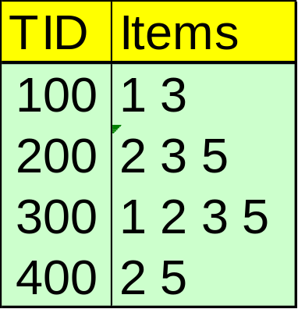
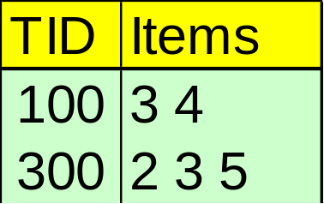
Constrained FP-Growth: Push a Succinct Constraint Deep
FP-Tree
Remove
infrequent
length 1
1-Projected DB
No Need to project on 2, 3, or 5
Constraint:
min{S.price } <= 1

Slide 77
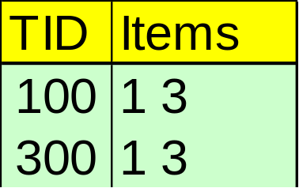
Constrained FP-Growth: Push a Data Anti-monotonic Constraint Deep
Remove from data
FP-Tree
Single branch, we are done
Constraint:
min{S.price } <= 1

Slide 78
Constrained FP-Growth: Push a Data Anti-monotonic Constraint Deep
TID | Transaction
10 | a, b, c, d, f, h
20 | b, c, d, f, g, h
30 | b, c, d, f, g
40 | a, c, e, f, g
TID | Transaction
10 | a, b, c, d, f, h
20 | b, c, d, f, g, h
30 | b, c, d, f, g
40 | a, c, e, f, g
FP-Tree
Item | Profit
a | 40
b | 0
c | -20
d | -15
e | -30
f | -10
g | 20
h | -5
B-Projected DB
Recursive
Data
Pruning
TID | Transaction
10 | a, c, d, f, h
20 | c, d, f, g, h
30 | c, d, f, g
B
FP-Tree
  Single branch:
    bcdfg: 2
Constraint:
range{S.price } > 25
min_sup >= 2

Slide 79
Convertible Constraints: Ordering Data in Transactions
TDB (min_sup=2)
Convert tough constraints into anti-monotone or monotone by properly ordering items
Examine C: avg(S.profit) ≥ 25
  Order items in value-descending order
    <a, f, g, d, b, h, c, e>
  If an itemset afb violates C
    So does afbh, afb*
    It becomes anti-monotone!
TID | Transaction
10 | a, b, c, d, f
20 | b, c, d, f, g, h
30 | a, c, d, e, f
40 | c, e, f, g
Item | Profit
a | 40
b | 0
c | -20
d | 10
e | -30
f | 30
g | 20
h | -10

Slide 80
Strongly Convertible Constraints
avg(X) ≥ 25 is convertible anti-monotone w.r.t. item value descending order R: <a, f, g, d, b, h, c, e>
  If an itemset af violates a constraint C, so does every itemset with af as prefix, such as afd
avg(X) ≥ 25 is convertible monotone w.r.t. item value ascending order R⁻¹: <e, c, h, b, d, g, f, a>
  If an itemset d satisfies a constraint C, so does itemsets df and dfa, which having d as a prefix
Thus, avg(X) ≥ 25 is strongly convertible
Item | Profit
a | 40
b | 0
c | -20
d | 10
e | -30
f | 30
g | 20
h | -10

Slide 81
Can Apriori Handle Convertible Constraints?
A convertible, not monotone nor anti-monotone nor succinct constraint cannot be pushed deep into the an Apriori mining algorithm
  Within the level wise framework, no direct pruning based on the constraint can be made
  Itemset df violates constraint C: avg(X) >= 25
  Since adf satisfies C, Apriori needs df to assemble adf, df cannot be pruned
But it can be pushed into frequent-pattern growth framework!
Item | Value
a | 40
b | 0
c | -20
d | 10
e | -30
f | 30
g | 20
h | -10

Slide 82
Pattern Space Pruning w. Convertible Constraints
C: avg(X) >= 25, min_sup=2
List items in every transaction in value descending order R: <a, f, g, d, b, h, c, e>
  C is convertible anti-monotone w.r.t. R
Scan TDB once
  remove infrequent items
    Item h is dropped
  Itemsets a and f are good, …
Projection-based mining
  Imposing an appropriate order on item projection
  Many tough constraints can be converted into (anti)-monotone
Item | Value
a | 40
f | 30
g | 20
d | 10
b | 0
h | -10
c | -20
e | -30
TDB (min_sup=2)
TID | Transaction
10 | a, f, d, b, c
20 | f, g, d, b, c
30 | a, f, d, c, e
40 | f, g, h, c, e

Slide 83
Handling Multiple Constraints
Different constraints may require different or even conflicting item-ordering
If there exists an order R s.t. both C₁ and C₂ are convertible w.r.t. R, then there is no conflict between the two convertible constraints
If there exists conflict on order of items
  Try to satisfy one constraint first
  Then using the order for the other constraint to mine frequent itemsets in the corresponding projected database

Slide 84
What Constraints Are Convertible?
Constraint | Convertible anti-monotone | Convertible monotone | Strongly convertible
avg(S) ≤ , ≥ v | Yes | Yes | Yes
median(S) ≤ , ≥ v | Yes | Yes | Yes
sum(S) ≤ v (items could be of any value, v ≥ 0) | Yes | No | No
sum(S) ≤ v (items could be of any value, v ≤ 0) | No | Yes | No
sum(S) ≥ v (items could be of any value, v ≥ 0) | No | Yes | No
sum(S) ≥ v (items could be of any value, v ≤ 0) | Yes | No | No
……

Slide 85
Constraint-Based Mining — A General Picture
Constraint | Anti-monotone | Monotone | Succinct
v ∈ S | no | yes | yes
S ⊇ V | no | yes | yes
S ⊆ V | yes | no | yes
min(S) ≤ v | no | yes | yes
min(S) ≥ v | yes | no | yes
max(S) ≤ v | yes | no | yes
max(S) ≥ v | no | yes | yes
count(S) ≤ v | yes | no | weakly
count(S) ≥ v | no | yes | weakly
sum(S) ≤ v ( a ∈ S, a ≥ 0 ) | yes | no | no
sum(S) ≥ v ( a ∈ S, a ≥ 0 ) | no | yes | no
range(S) ≤ v | yes | no | no
range(S) ≥ v | no | yes | no
avg(S) θ v, θ ∈ { =, ≤, ≥ } | convertible | convertible | no
support(S) ≥ ξ | yes | no | no
support(S) ≤ ξ | no | yes | no

Slide 86
Mining Colossal Frequent Patterns
F. Zhu, X. Yan, J. Han, P. S. Yu, and H. Cheng, “Mining Colossal Frequent Patterns by Core Pattern Fusion”, ICDE'07.
We have many algorithms, but can we mine large (i.e., colossal) patterns? ― such as just size around 50 to 100? Unfortunately, not!
Why not? ― the curse of “downward closure” of frequent patterns
  The “downward closure” property
    Any sub-pattern of a frequent pattern is frequent.
  Example. If (a₁, a₂, …, a₁₀₀) is frequent, then a₁, a₂, …, a₁₀₀, (a₁, a₂), (a₁, a₃), …, (a₁, a₁₀₀), (a₁, a₂, a₃), … are all frequent! There are about 2¹⁰⁰ such frequent itemsets!
  No matter using breadth-first search (e.g., Apriori) or depth-first search (FPgrowth), we have to examine so many patterns
Thus the downward closure property leads to explosion!

Slide 87
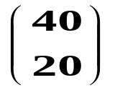
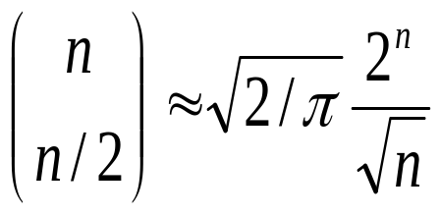
Colossal Patterns: A Motivating Example
Let’s make a set of 40 transactions
Closed/maximal patterns may partially alleviate the problem but not really solve it: We often need to mine scattered large patterns!
Let the minimum support threshold σ= 20
There are frequent patterns of size 20
Each is closed and maximal
# patterns =
The size of the answer set is exponential to n
T1 = 1 2 3 4 ….. 39 40
T2 = 1 2 3 4 ….. 39 40
: .
: .
: .
: .
T40=1 2 3 4 ….. 39 40
Then delete the items on the diagonal
T1 = 2 3 4 ….. 39 40
T2 = 1 3 4 ….. 39 40
: .
: .
: .
: .
T40=1 2 3 4 …… 39

Slide 88
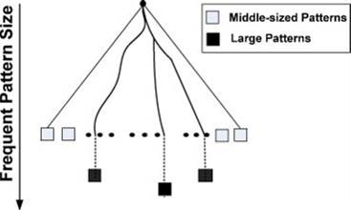
Colossal Pattern Set: Small but Interesting
It is often the case that only a small number of patterns are colossal, i.e., of large size
Colossal patterns are usually attached with greater importance than those of small pattern sizes

Slide 89
Mining Colossal Patterns: Motivation and Philosophy
Motivation: Many real-world tasks need mining colossal patterns
  Micro-array analysis in bioinformatics (when support is low)
  Biological sequence patterns
  Biological/sociological/information graph pattern mining
No hope for completeness
  If the mining of mid-sized patterns is explosive in size, there is no hope to find colossal patterns efficiently by insisting “complete set” mining philosophy
Jumping out of the swamp of the mid-sized results
  What we may develop is a philosophy that may jump out of the swamp of mid-sized results that are explosive in size and jump to reach colossal patterns
Striving for mining almost complete colossal patterns
  The key is to develop a mechanism that may quickly reach colossal patterns and discover most of them

Slide 90
Alas, A Show of Colossal Pattern Mining!
Let the min-support threshold σ= 20
Then there are closed/maximal frequent patterns of size 20
However, there is only one with size greater than 20, (i.e., colossal):
  α= {41,42,…,79} of size 39
T1 = 2 3 4 ….. 39 40
T2 = 1 3 4 ….. 39 40
: .
: .
: .
: .
T40=1 2 3 4 …… 39
T41= 41 42 43 ….. 79
T42= 41 42 43 ….. 79
: .
: .
T60= 41 42 43 … 79
The existing fastest mining algorithms (e.g., FPClose, LCM) fail to complete running
Our algorithm outputs this colossal pattern in seconds

Slide 91
Methodology of Pattern-Fusion Strategy
Pattern-Fusion traverses the tree in a bounded-breadth way
  Always pushes down a frontier of a bounded-size candidate pool
  Only a fixed number of patterns in the current candidate pool will be used as the starting nodes to go down in the pattern tree ― thus avoids the exponential search space
Pattern-Fusion identifies “shortcuts” whenever possible
  Pattern growth is not performed by single-item addition but by leaps and bounded: agglomeration of multiple patterns in the pool
  These shortcuts will direct the search down the tree much more rapidly towards the colossal patterns

Slide 92
Observation: Colossal Patterns and Core Patterns
Transaction Database D
A colossal pattern α
α
D
α1
Dα_{k}
α2
Dα1
Dα2
Dα
αk
Subpatterns α₁ to α_{k} cluster tightly around the colossal pattern α by sharing a similar support. We call such subpatterns core patterns of α

Slide 93
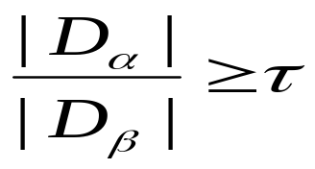

Robustness of Colossal Patterns
Core Patterns
Intuitively, for a frequent pattern α, a subpattern β is a τ-core pattern of α if β shares a similar support set with α, i.e.,
    where τ is called the core ratio
Robustness of Colossal Patterns
A colossal pattern is robust in the sense that it tends to have much more core patterns than small patterns

Slide 94
Example: Core Patterns
A colossal pattern has far more core patterns than a small-sized pattern
A colossal pattern has far more core descendants of a smaller size c
A random draw from a complete set of pattern of size c would more likely to pick a core descendant of a colossal pattern
A colossal pattern can be generated by merging a set of core patterns
Transaction (# of Ts) | Core Patterns (τ = 0.5)
(abe) (100) | (abe), (ab), (be), (ae), (e)
(bcf) (100) | (bcf), (bc), (bf)
(acf) (100) | (acf), (ac), (af)
(abcef) (100) | (ab), (ac), (af), (ae), (bc), (bf), (be) (ce), (fe), (e), (abc), (abf), (abe), (ace), (acf), (afe), (bcf), (bce), (bfe), (cfe), (abcf), (abce), (bcfe), (acfe), (abfe), (abcef)

Slide 95

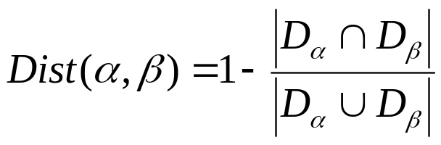
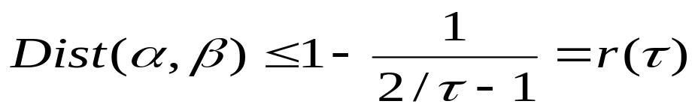
Robustness of Colossal Patterns
(d,τ)-robustness: A pattern α is (d, τ)-robust if d is the maximum number of items that can be removed from α for the resulting pattern to remain a τ-core pattern of α
For a (d,τ)-robust pattern α, it has core patterns
  A colossal patterns tend to have a large number of core patterns
Pattern distance: For patterns α and β, the pattern distance of α and β is defined to be
If two patterns α and β are both core patterns of a same pattern, they would be bounded by a “ball” of a radius specified by their core ratio τ
Once we identify one core pattern, we will be able to find all the other core patterns by a bounding ball of radius r(τ)

Slide 96
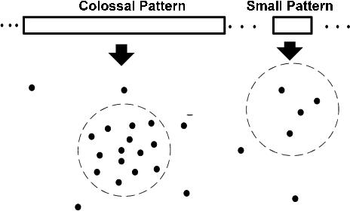
Colossal Patterns Correspond to Dense Balls
Due to their robustness, colossal patterns correspond to dense balls
  Ω( 2^d) in population
A random draw in the pattern space will hit somewhere in the ball with high probability

Slide 97
Idea of Pattern-Fusion Algorithm
Generate a complete set of frequent patterns up to a small size
Randomly pick a pattern β, and β has a high probability to be a core-descendant of some colossal pattern α
Identify all α’s descendants in this complete set, and merge all of them ― This would generate a much larger core-descendant of α
In the same fashion, we select K patterns. This set of larger core-descendants will be the candidate pool for the next iteration

Slide 98
Pattern-Fusion: The Algorithm
Initialization (Initial pool): Use an existing algorithm to mine all frequent patterns up to a small size, e.g., 3
Iteration (Iterative Pattern Fusion):
  At each iteration, k seed patterns are randomly picked from the current pattern pool
  For each seed pattern thus picked, we find all the patterns within a bounding ball centered at the seed pattern
  All these patterns found are fused together to generate a set of super-patterns. All the super-patterns thus generated form a new pool for the next iteration
Termination: when the current pool contains no more than K patterns at the beginning of an iteration

Slide 99
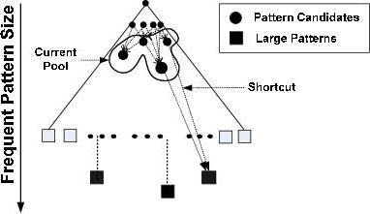
Why Is Pattern-Fusion Efficient?
A bounded-breadth pattern tree traversal
  It avoids explosion in mining mid-sized ones
  Randomness comes to help to stay on the right path
Ability to identify “short-cuts” and take “leaps”
  fuse small patterns together in one step to generate new patterns of significant sizes
  Efficiency

Slide 100
Pattern-Fusion Leads to Good Approximation
Gearing toward colossal patterns
  The larger the pattern, the greater the chance it will be generated
Catching outliers
  The more distinct the pattern, the greater the chance it will be generated

Slide 101
Experimental Setting
Synthetic data set
  Diag_{n} an n x (n-1) table where i^{th} row has integers from 1 to n except i. Each row is taken as an itemset. min_support is n/2.
Real data set
  Replace: A program trace data set collected from the “replace” program, widely used in software engineering research
  ALL: A popular gene expression data set, a clinical data on ALL-AML leukemia (www.broad.mit.edu/tools/data.html).
    Each item is a column, representing the activitiy level of gene/protein in the same
    Frequent pattern would reveal important correlation between gene expression patterns and disease outcomes

Slide 102
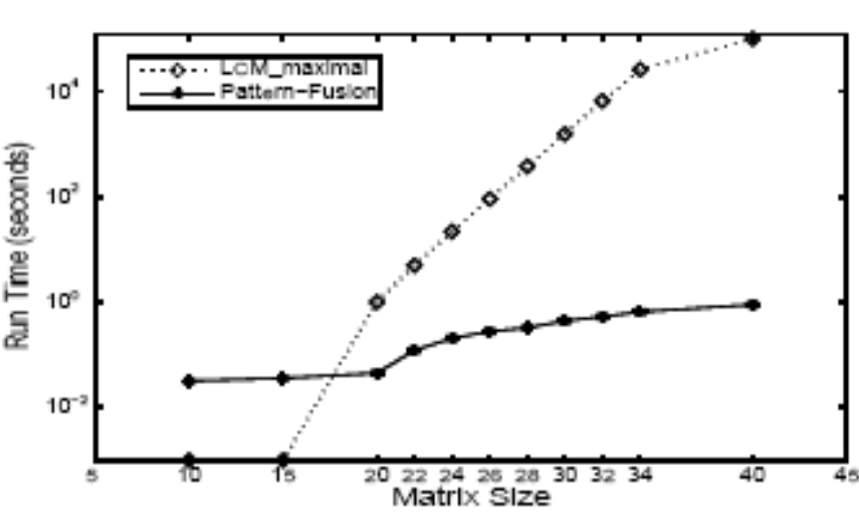
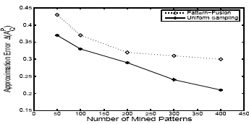
Experiment Results on Diag_{n}
LCM run time increases exponentially with pattern size n
Pattern-Fusion finishes efficiently
The approximation error of Pattern-Fusion (with min-sup 20) in comparison with the complete set) is rather close to uniform sampling (which randomly picks K patterns from the complete answer set)

Slide 103
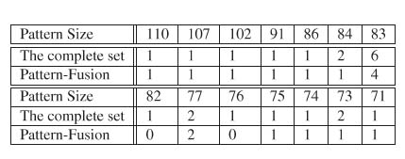
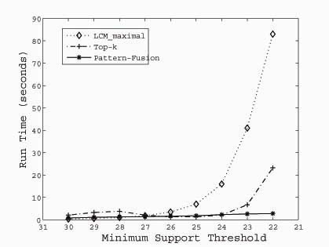
Experimental Results on ALL
ALL: A popular gene expression data set with 38 transactions, each with 866 columns
  There are 1736 items in total
  The table shows a high frequency threshold of 30

Slide 104
Experimental Results on REPLACE
REPLACE
  A program trace data set, recording 4395 calls and transitions
  The data set contains 4395 transactions with 57 items in total
  With support threshold of 0.03, the largest patterns are of size 44
  They are all discovered by Pattern-Fusion with different settings of K and τ, when started with an initial pool of 20948 patterns of size <=3

Slide 105
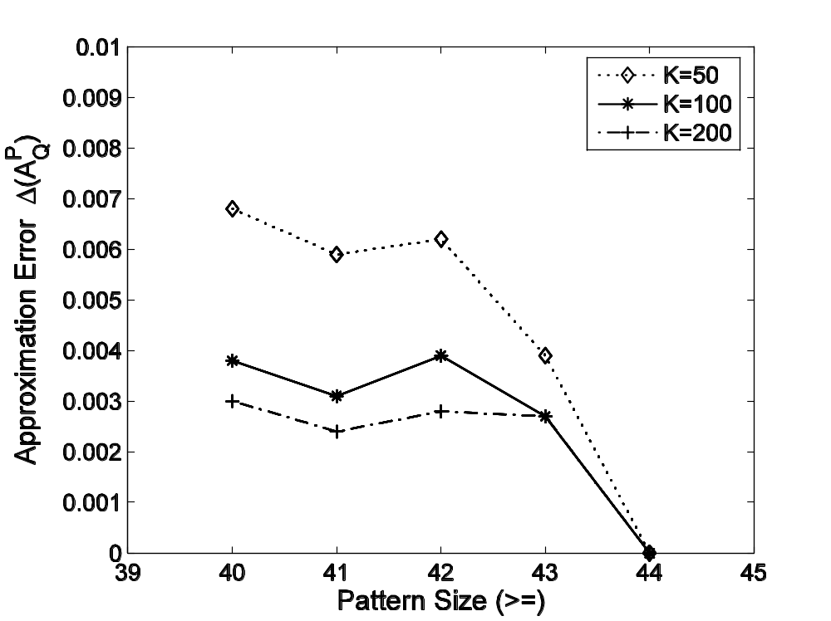
Experimental Results on REPLACE
Approximation error when compared with the complete mining result
Example. Out of the total 98 patterns of size >=42, when K=100, Pattern-Fusion returns 80 of them
A good approximation to the colossal patterns in the sense that any pattern in the complete set is on average at most 0.17 items away from one of these 80 patterns

Slide 106
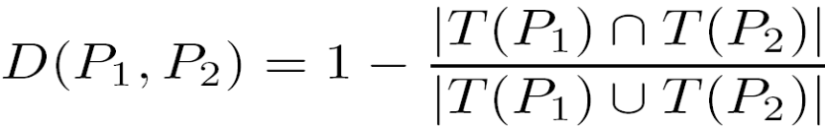
Mining Compressed Patterns: δ-clustering
Why compressed patterns?
  too many, but less meaningful
Pattern distance measure
δ-clustering: For each pattern P, find all patterns which can be expressed by P and their distance to P are within δ (δ-cover)
All patterns in the cluster can be represented by P
Xin et al., “Mining Compressed Frequent-Pattern Sets”, VLDB’05
ID | Item-Sets | Support
P1 | {38,16,18,12} | 205227
P2 | {38,16,18,12,17} | 205211
P3 | {39,38,16,18,12,17} | 101758
P4 | {39,16,18,12,17} | 161563
P5 | {39,16,18,12} | 161576
Closed frequent pattern
  Report P1, P2, P3, P4, P5
  Emphasize too much on support
  no compression
Max-pattern, P3: info loss
A desirable output: P2, P3, P4

Slide 107
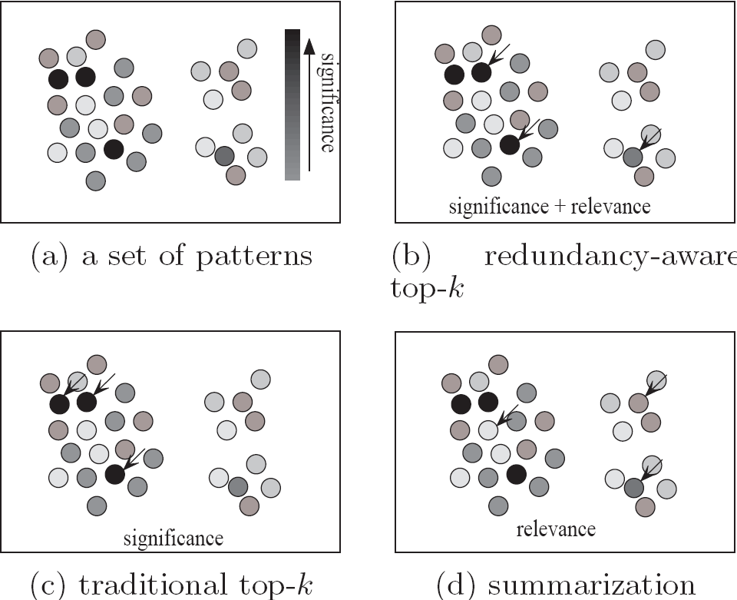
Redundancy-Award Top-k Patterns
Why redundancy-aware top-k patterns?
Desired patterns: high significance & low redundancy
Propose the MMS (Maximal Marginal Significance) for measuring the combined significance of a pattern set
Xin et al., Extracting Redundancy-Aware Top-K Patterns, KDD’06

Slide 108
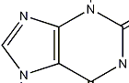
How to Understand and Interpret Patterns?
Do they all make sense?
What do they mean?
How are they useful?
diaper
beer
female sterile (2) tekele
morphological info. and simple statistics
Semantic Information
Not all frequent patterns are useful, only meaningful ones …
Annotate patterns with semantic information

Slide 109
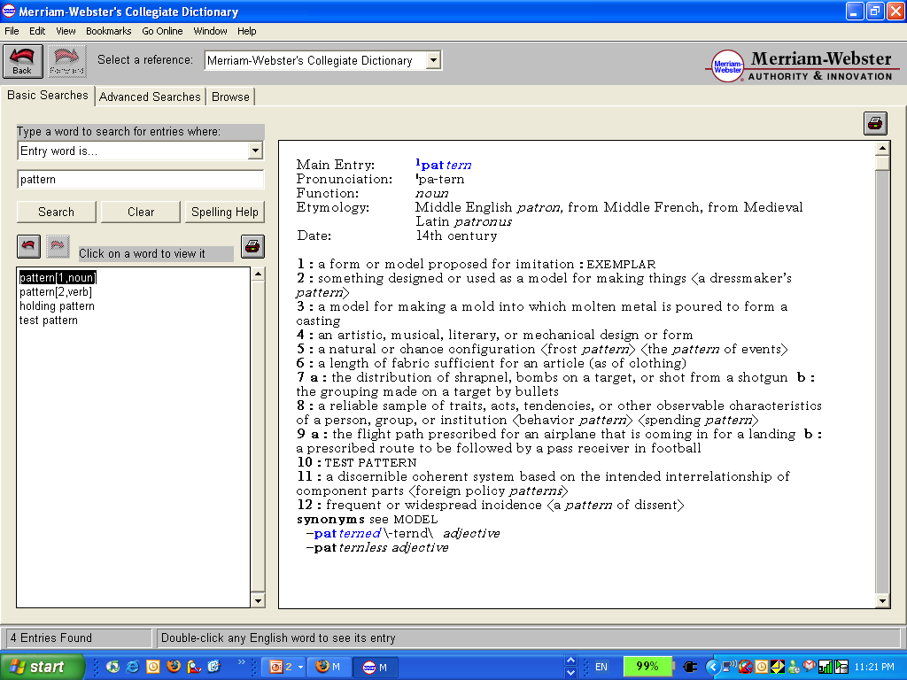
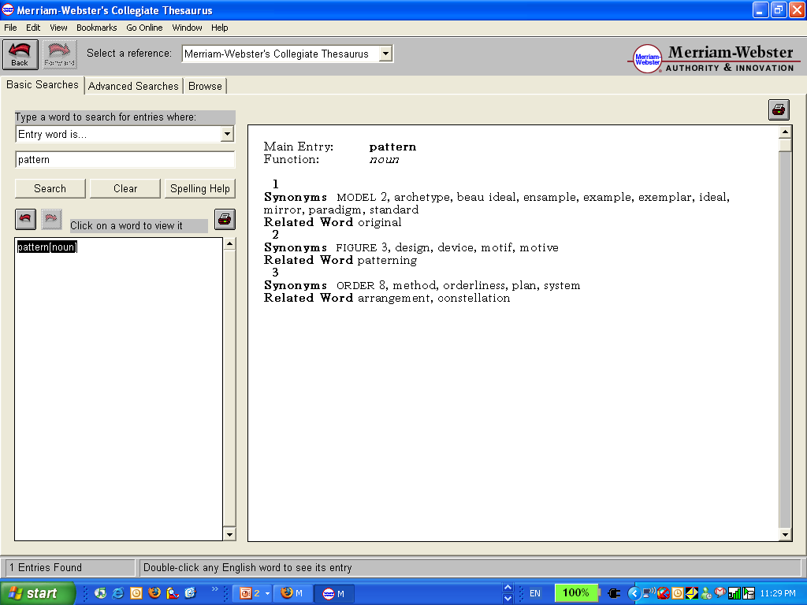
A Dictionary Analogy
Word: “pattern” – from Merriam-Webster
Non-semantic info.
Definitions indicating
semantics
Examples of Usage
Synonyms
Related Words

Slide 110
Semantic Analysis with Context Models
Task1: Model the context of a frequent pattern
  Based on the Context Model…
Task2: Extract strongest context indicators
Task3: Extract representative transactions
Task4: Extract semantically similar patterns

Slide 111
Annotating DBLP Co-authorship & Title Pattern
Database:
Frequent Patterns
Authors
Title
X.Yan, P. Yu, J. Han
Substructure Similarity Search
in Graph Databases
P₁: { x_yan, j_han }
Frequent Itemset
…
…
…
…
P₂: “substructure search”
Semantic Annotations
Pattern | { x_yan, j_han}
Non | Sup = …
CI | {p_yu}, graph pattern, …
Trans. | gSpan: graph-base……
SSPs | { j_wang }, {j_han, p_yu}, …
Context Units
< { p_yu, j_han}, { d_xin }, … , “graph pattern”,
… “substructure similarity”, … >
Pattern = {xifeng_yan, jiawei_han}
Annotation Results:
Context Indicator (CI) | graph; {philip_yu}; mine close; graph pattern; sequential pattern; …
Representative Transactions (Trans) | > gSpan: graph-base substructure pattern mining; > mining close relational graph connect constraint; …
Semantically Similar Patterns (SSP) | {jiawei_han, philip_yu}; {jian_pei, jiawei_han}; {jiong_yang, philip_yu, wei_wang}; …

Slide 112
Summary
Basic concepts: association rules, support-confident framework, closed and max-patterns
Scalable frequent pattern mining methods
  Apriori (Candidate generation & test)
  Projection-based (FPgrowth, CLOSET+, ...)
  Vertical format approach (ECLAT, CHARM, ...)
Which patterns are interesting?
  Pattern evaluation methods

Slide 113
Summary …
Mining patterns in multi-level, multi dimensional space
Mining rare and negative patterns
Constraint-based pattern mining
Specialized methods for mining high-dimensional data and colossal patterns
Mining compressed or approximate patterns
Pattern exploration and understanding: Semantic annotation of frequent patterns

